Slide 1
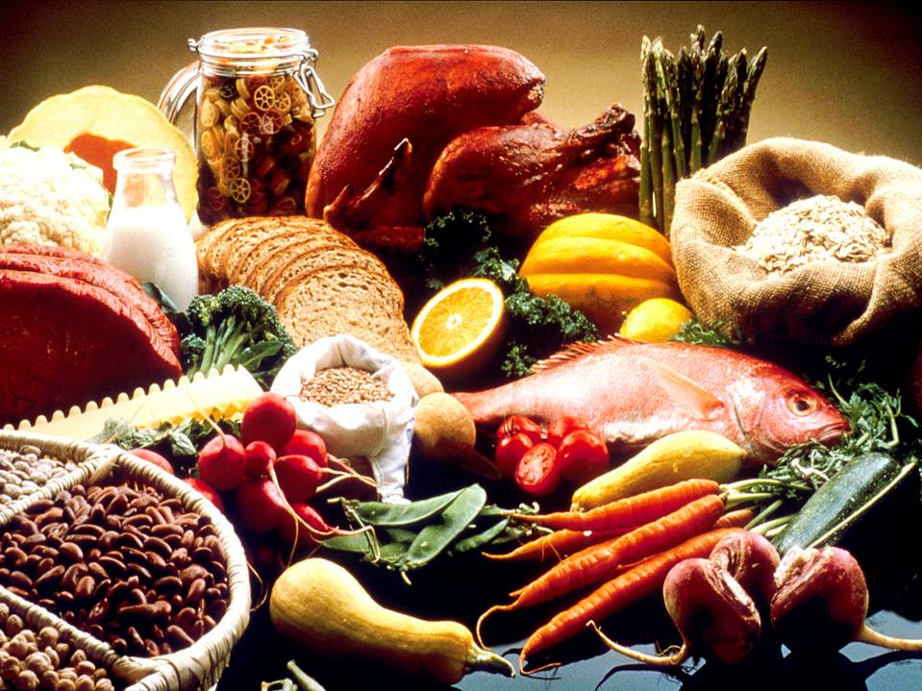
Nutrition
Photo courtesy of National Cancer Institute
A Presentation by Jessica Frank, Maria Fratangelo, and Tejhra White

Slide 2
Standards
Math
  2.6.A.2.a Read, write, and represent fractions as parts of a single region using symbols or models with denominators of 2, 3, or 4
Science
  2.6.E.2.a. Discuss the importance of physical fitness and what it means to each individual.
  2.6.F.1.a. Classify foods into groups according to My Plate.

Slide 3
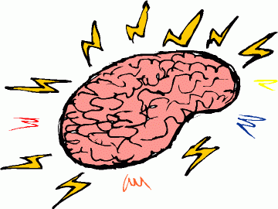
Brain Target One: Setting the Emotional Climate for Learning
Food is motivational!
Routines were established.
A concept map was used to keep children focused.
Each student received a food journal, which included a copy of the concept map.
A “Healthy Living” PowerPoint presentation was shown at the start of the unit. This included pictures of celebrities and athletes exercising.
Notes:
We had the children try different foods and recipes.
Each food group had a certain routine that we followed including exercise, reading a book, following a recipe, and cool down.
Display concept map.

Slide 4
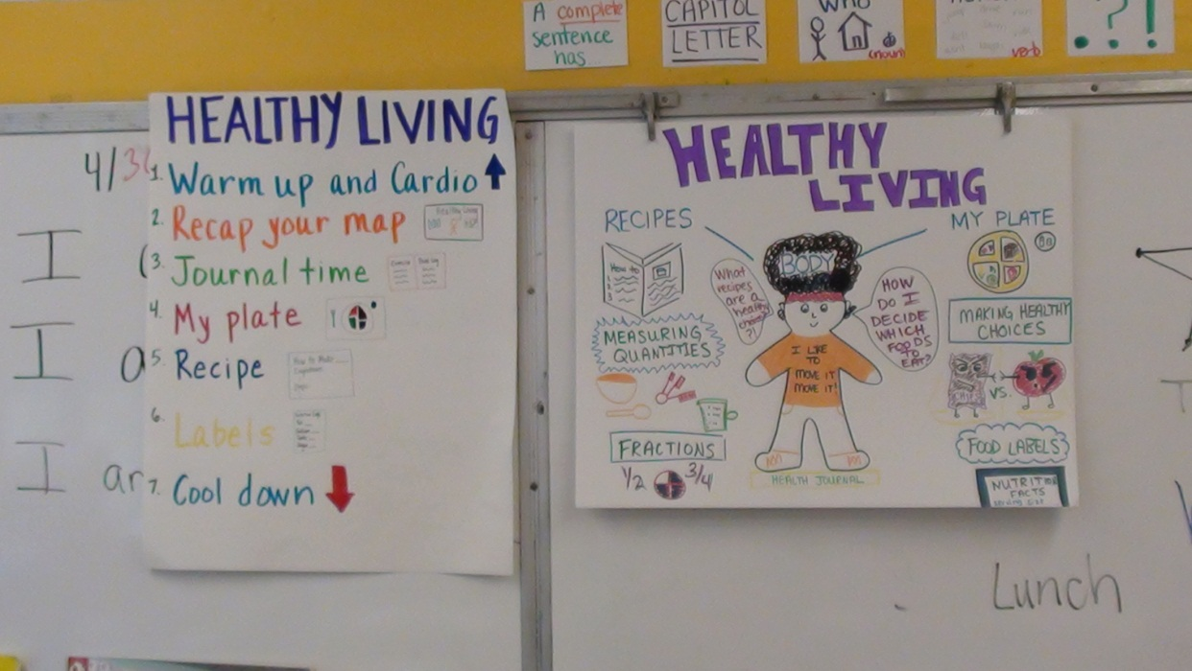

Slide 5
Brain Target Two: Creating the Physical Learning Environment
Concept map
Journals
Student displays
Photography
Notes:
Students were always within sight of the concept map.
Journals were available to students every day in a neat and orderly fashion.
Displays of student work were evident throughout the room and within the food journals.
Photographs of students working were taken frequently and shared with children.

Slide 6
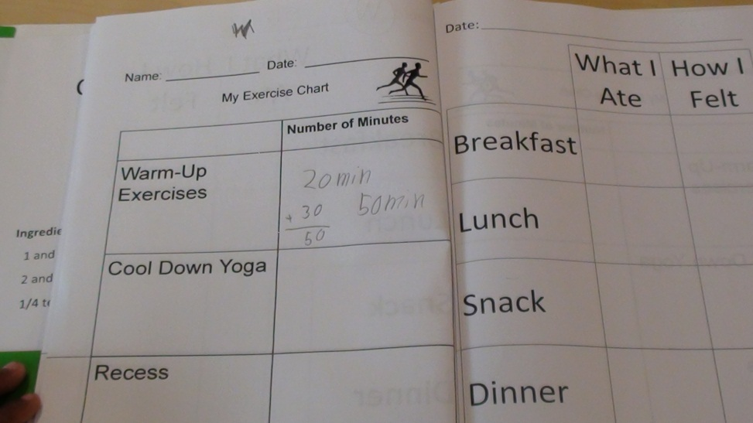

Slide 7
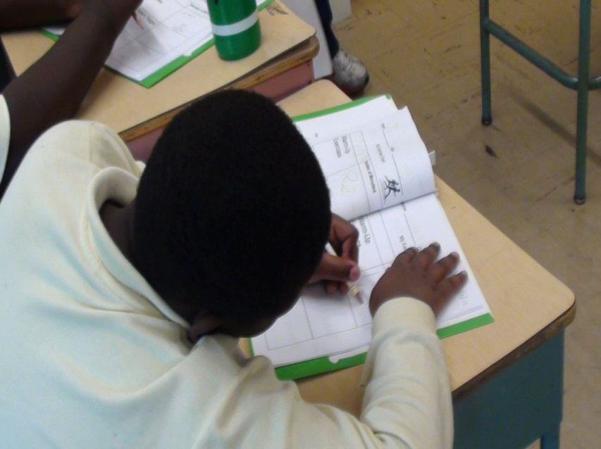
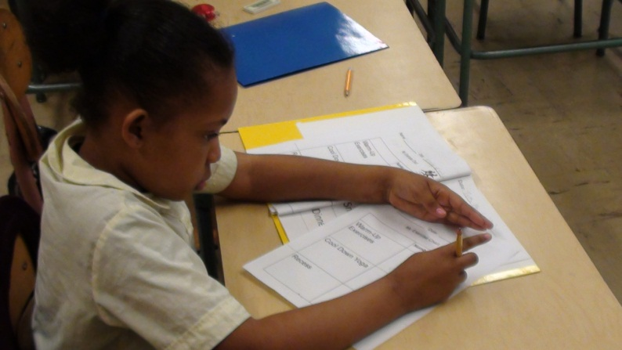
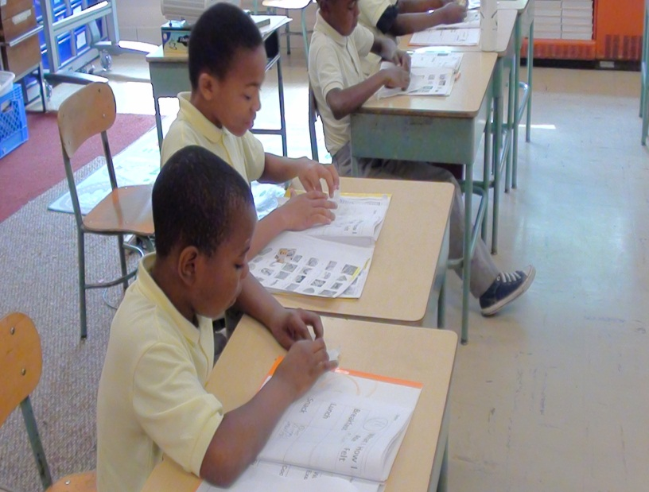
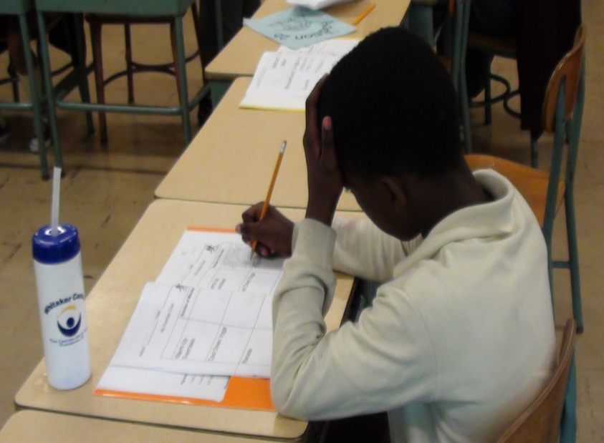

Slide 8
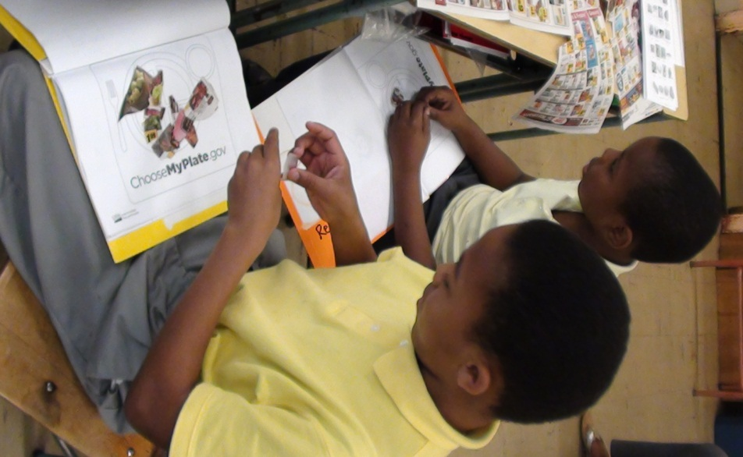
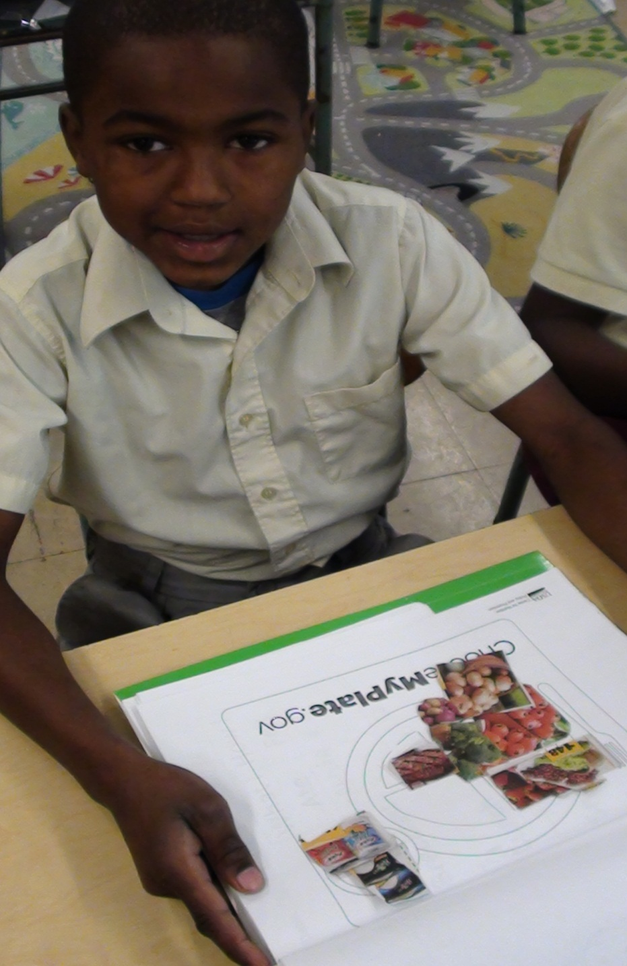
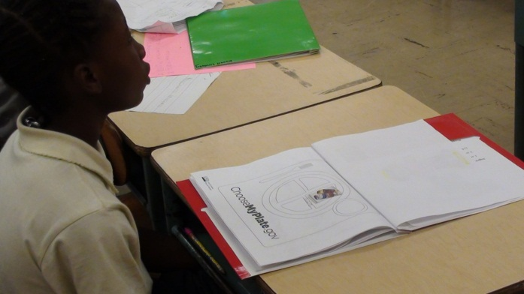

Slide 9
Brain Target Three: Designing the Learning Experience
Concept Map
Standards Met:
Math | 2.6.A.2.a Read, write, and represent fractions as parts of a single region using symbols or models with denominators of 2, 3, or 4
Science | 2.6.E.2.a. Discuss the importance of physical fitness and what it means to each individual. 2.6.F.1.a. Classify foods into groups according to My Plate.
Notes:
Learning goals were managed through a concept map.
We met the following state standards.

Slide 10
Brain Target Four: Teaching for Mastery of Skills, Content, and Concepts
Pretest
Food bookmark
PowerPoint presentations of each component of My Plate
Who am I?
Notes:
Pretest was given so we would know what information needs to be learned.
These bookmarks were used throughout the unit to help students understand key vocabulary words and use them in their writing.
Critical thinking was necessary to listen to clues from each food group and identify the food being disguised.

Slide 11
Pretest
Name __________________________________________________
Date ___________________________________________________
Circle the foods you like to eat.
What makes food healthy?
Look at these food items. Circle the healthy foods.

Slide 12
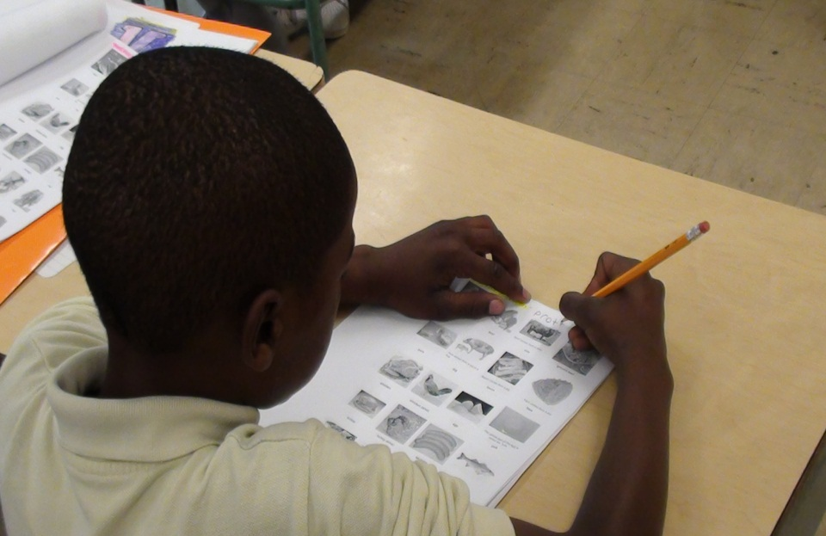
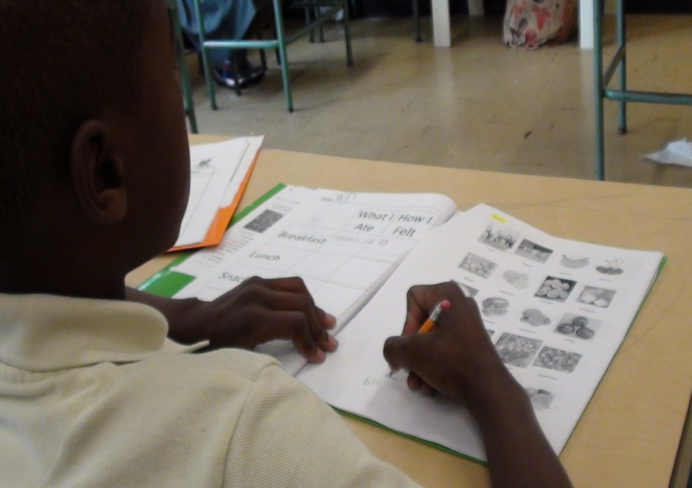
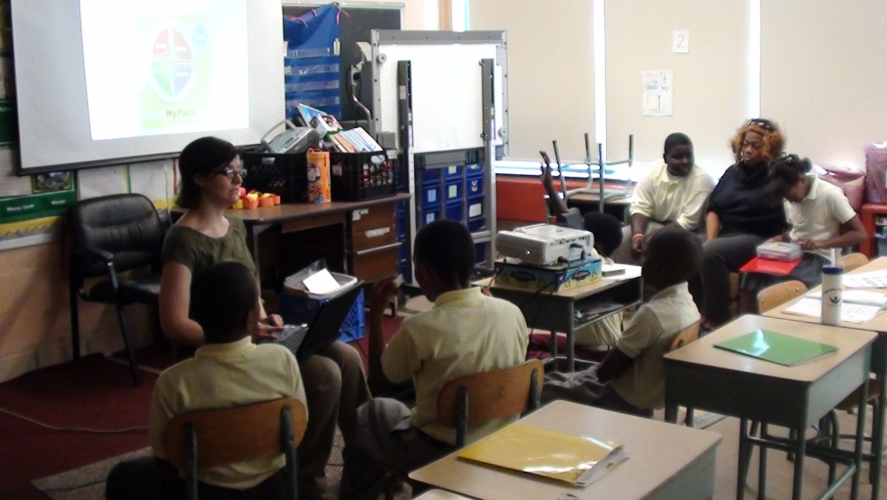
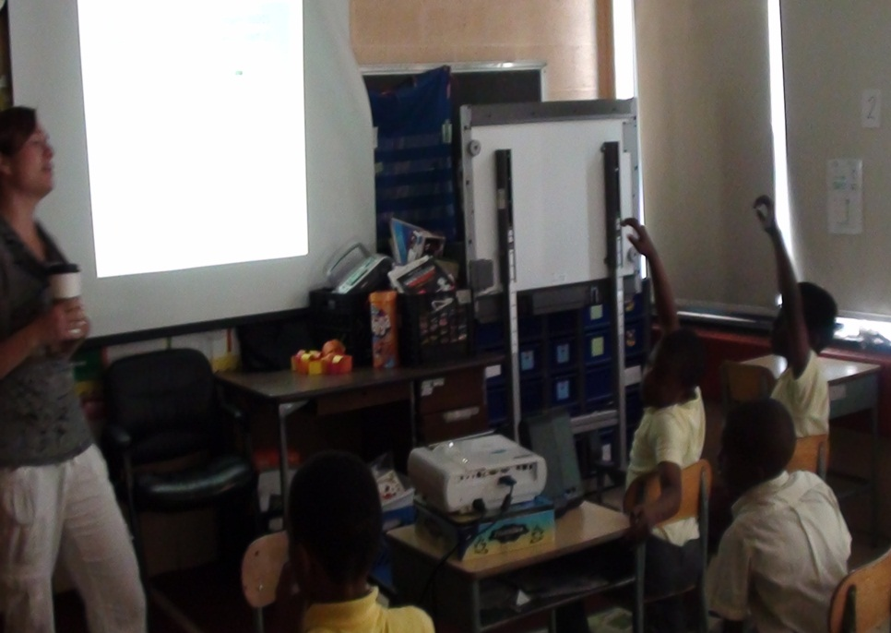

Slide 13
Brain Target Five: Teaching for Extension and Application of Knowledge
Movement
Food journals
Tastings
Recipes
Food group hunts
Reading food labels
Notes:
Students were reminded daily of the importance of exercise by going outside every day and recording their exercise in their exercise logs.
Students were made more aware of their nutritional habits by keeping a daily food journal.
As each component of MyPlate was introduced, students had the opportunity to try food items within the component
Children need to know fractions to be able to follow recipes in real life.
Students kept copies of recipes in their food journal folders.
Look in circulars and cut out pictures of each food group.
Children could identify healthy and unhealthy foods by reading the labels.

Slide 14
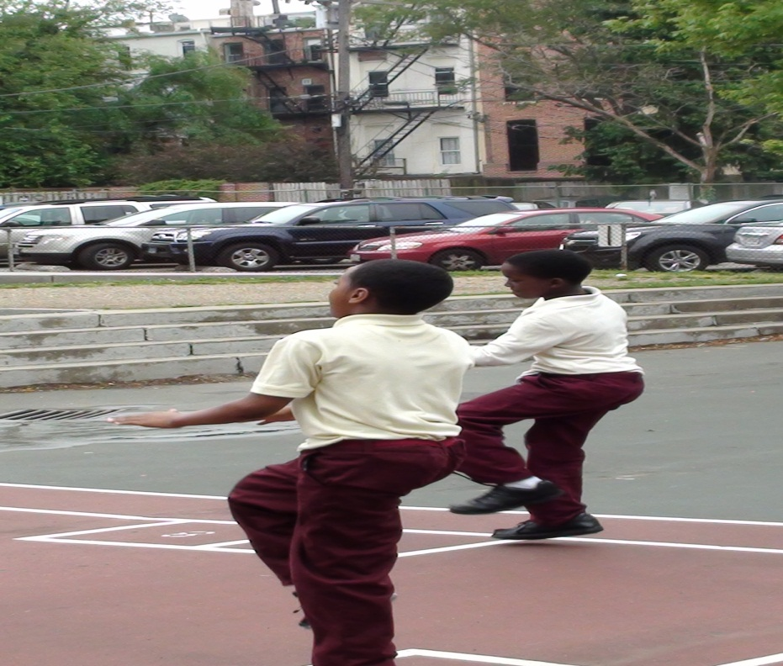
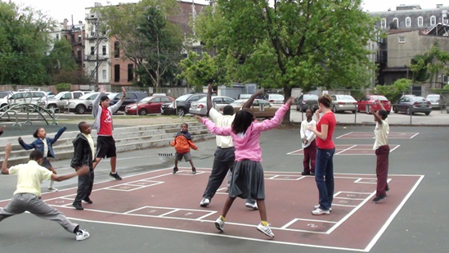
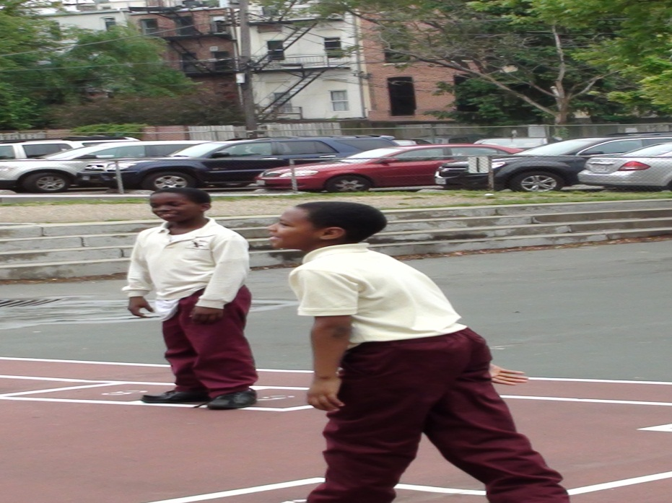
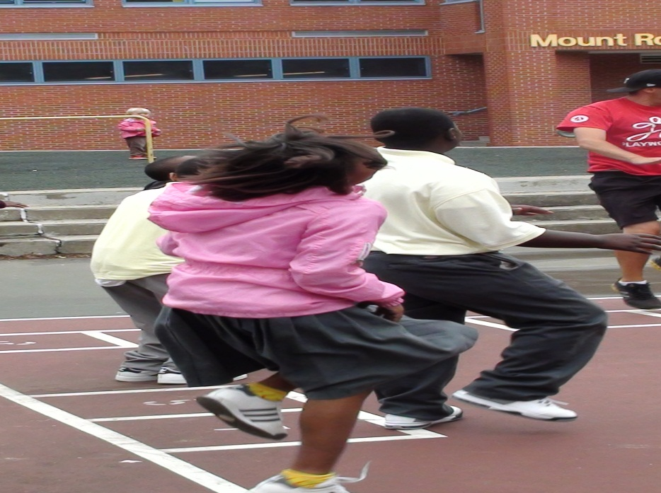

Slide 15
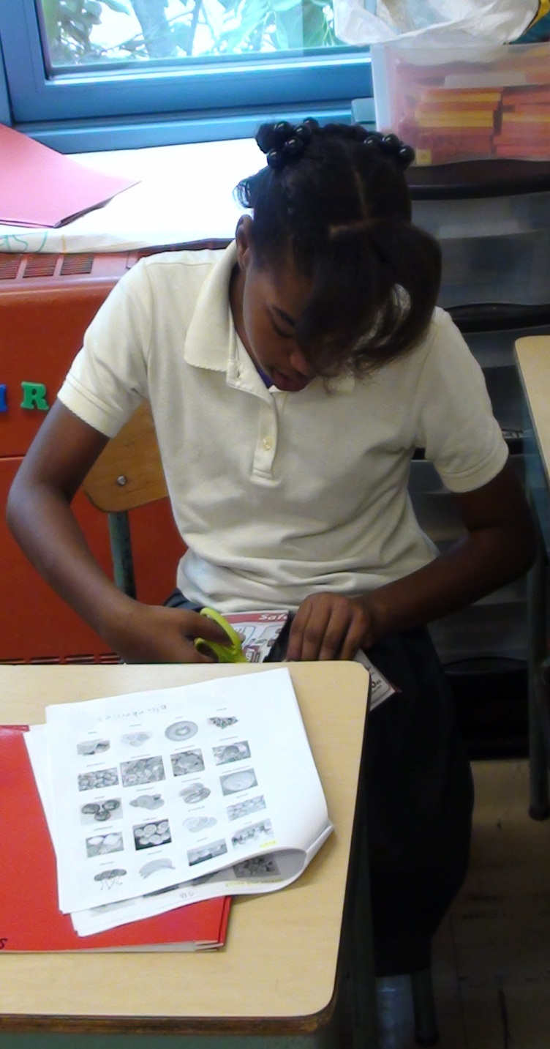
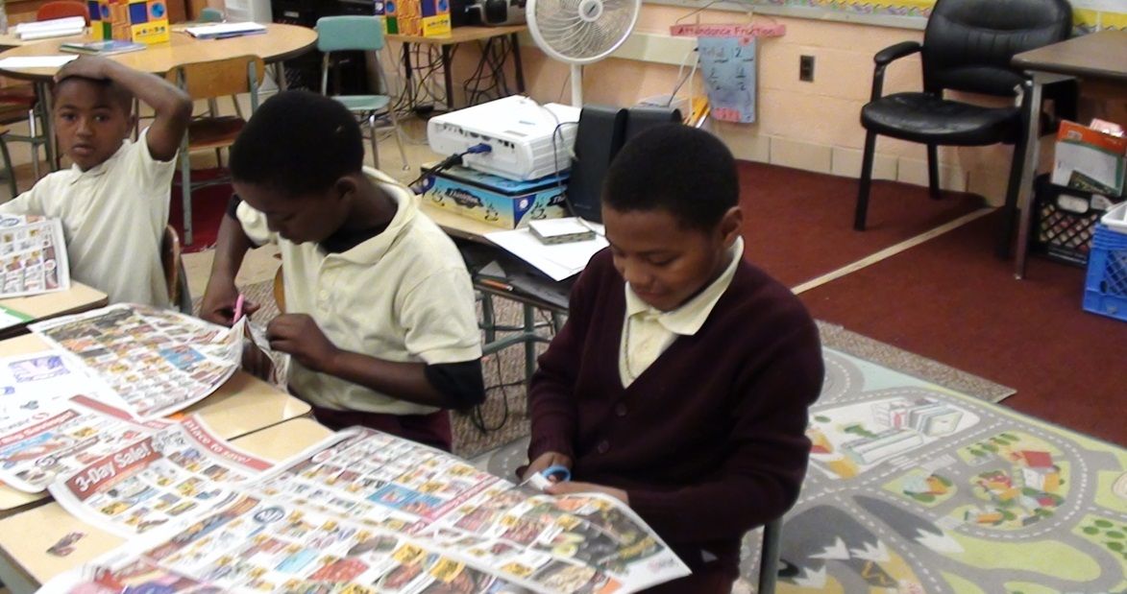
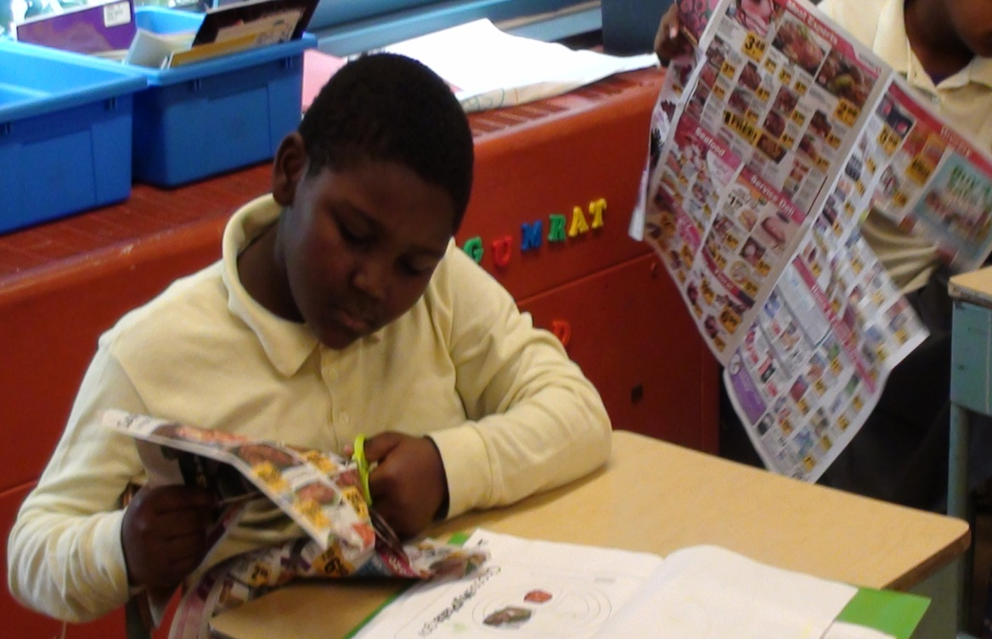

Slide 16
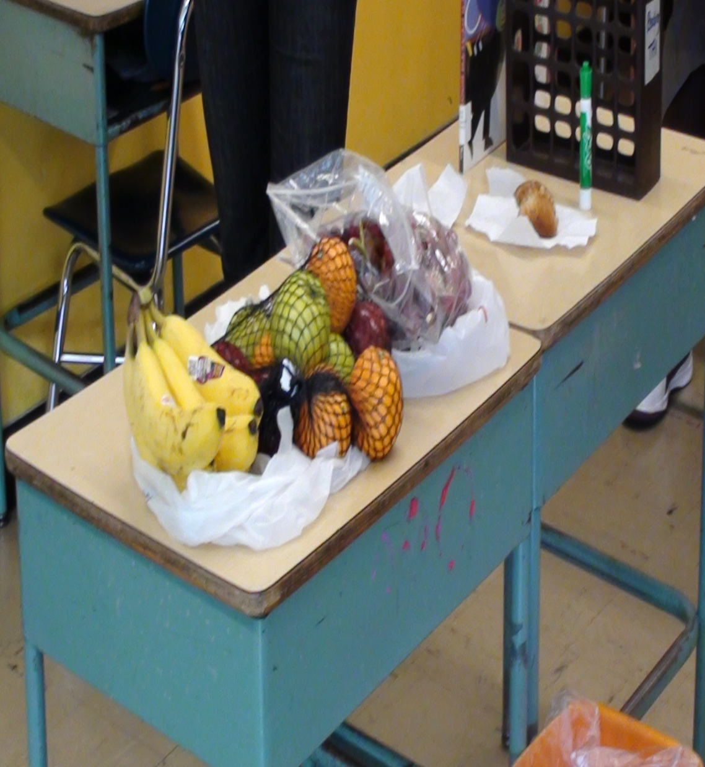

Slide 17
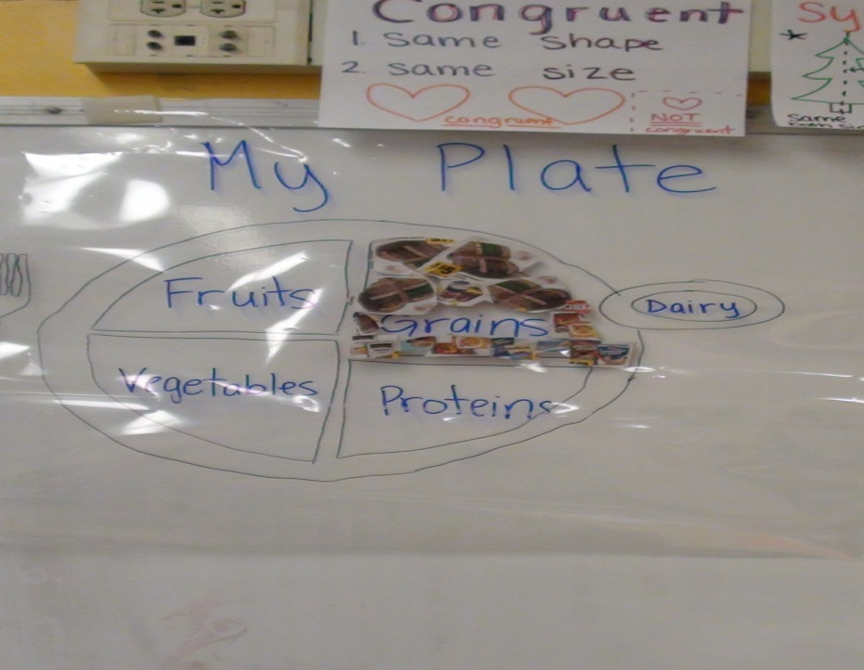
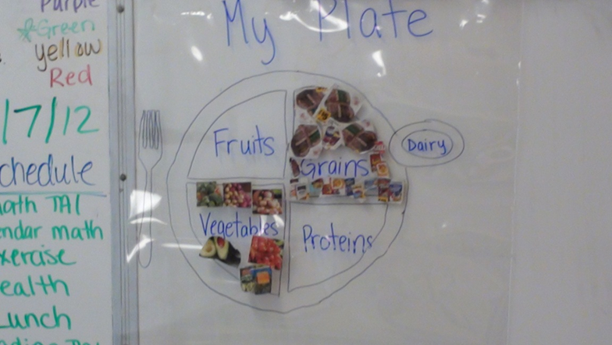
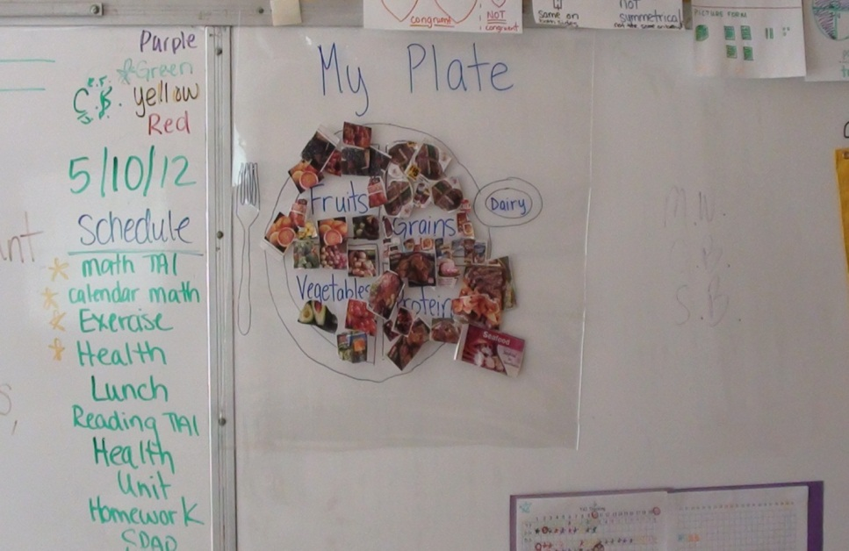
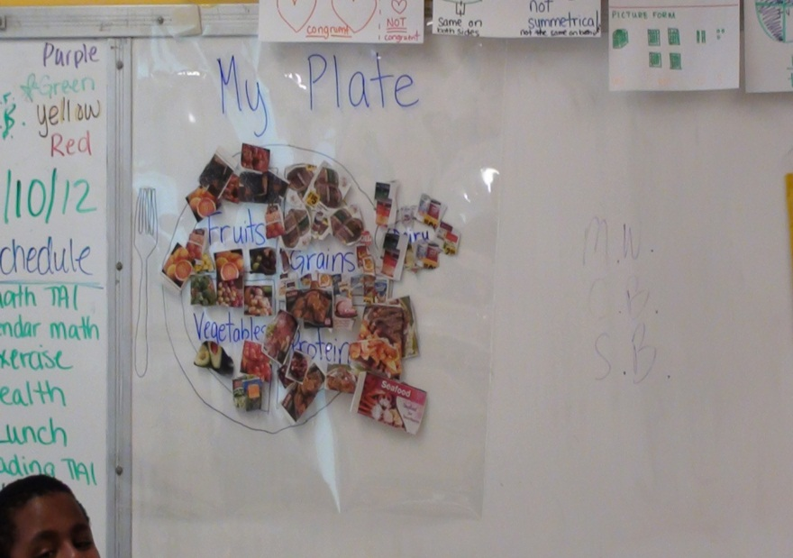

Slide 18
Brain Target Six: Evaluating Learning
Nutrition Poster
  Completed a food group hunt to make My Plate
  Made “My Food Face” using fruits, vegetables, and cheeses
Notes:
1. Students created a nutrition poster which included facts about the food groups and a face made out of a healthy meal.

Slide 19
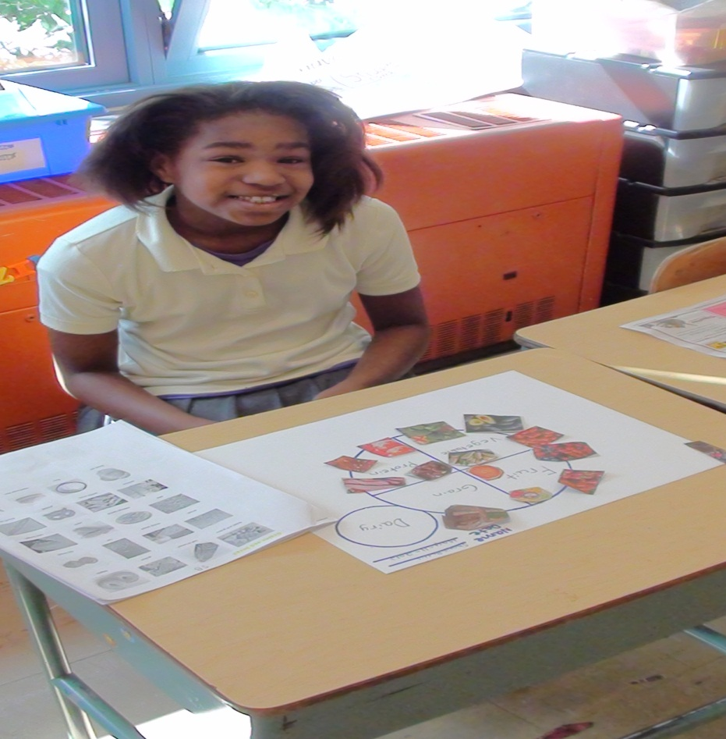
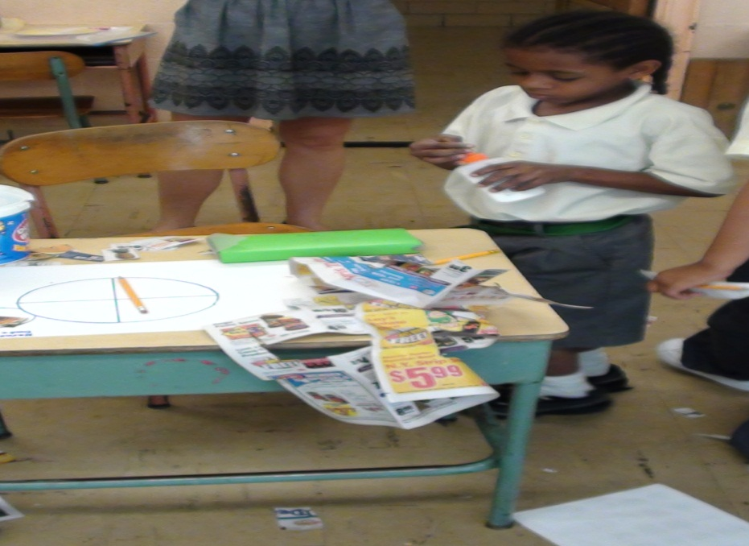
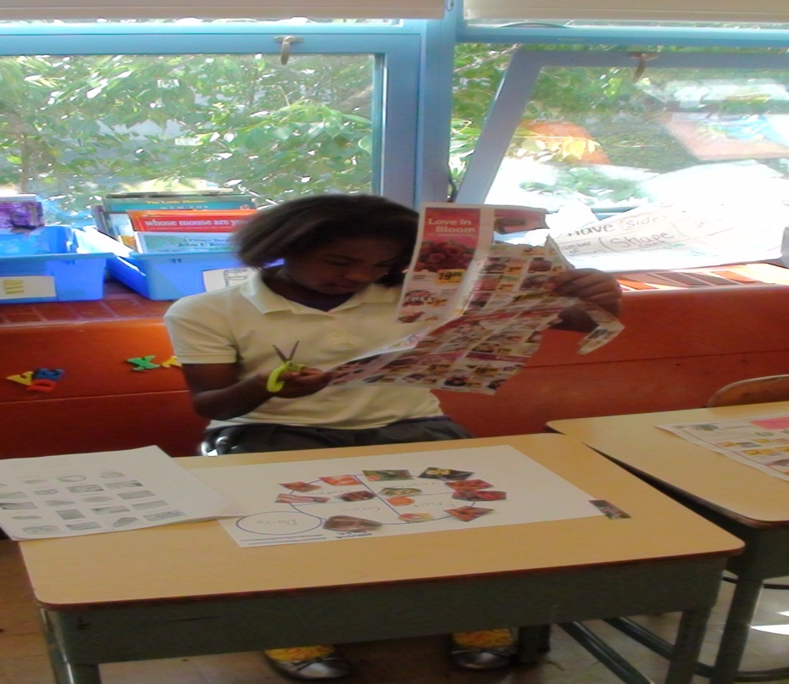
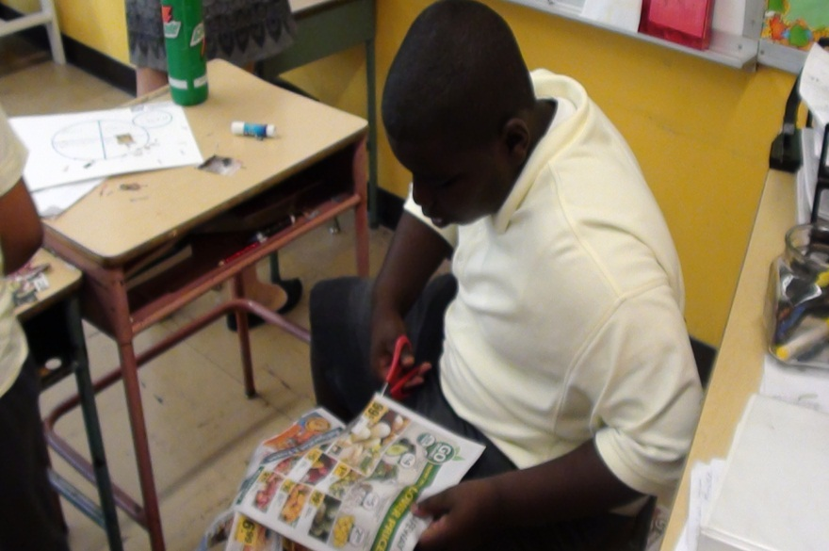

Slide 20
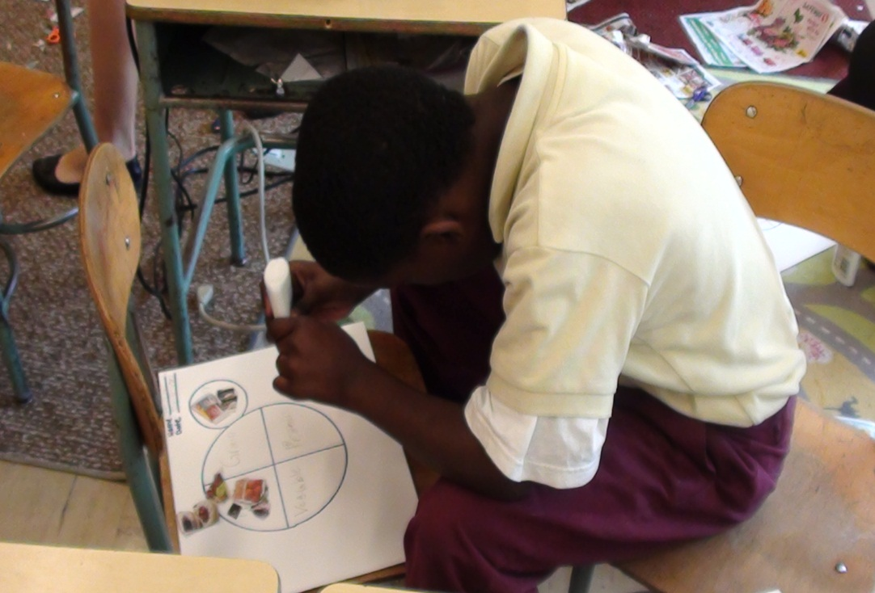
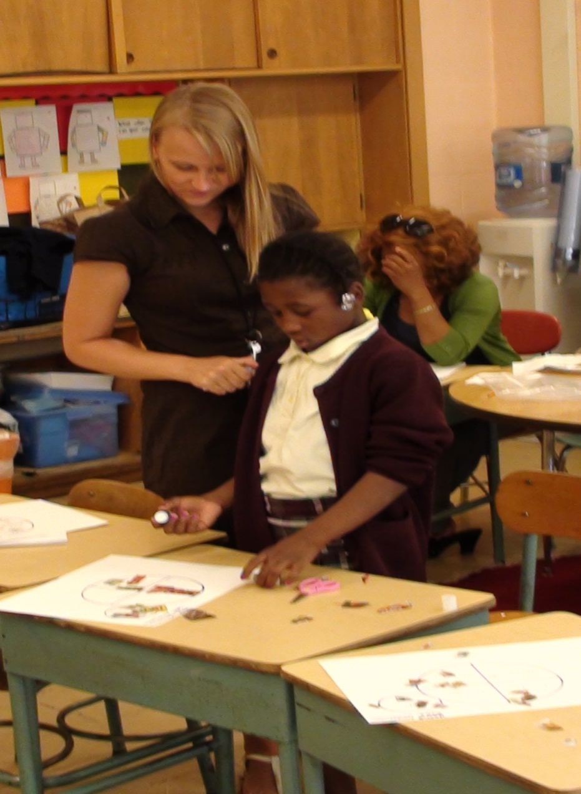
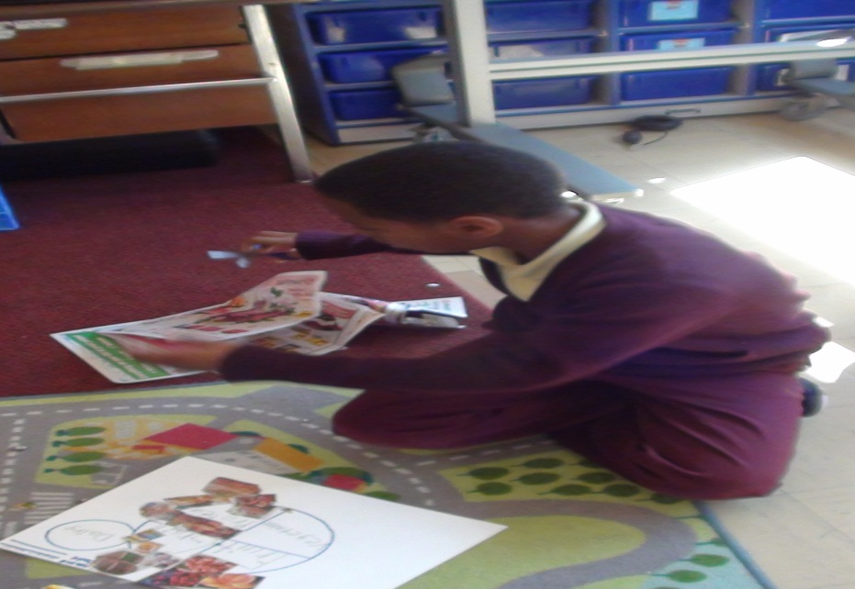

Slide 21
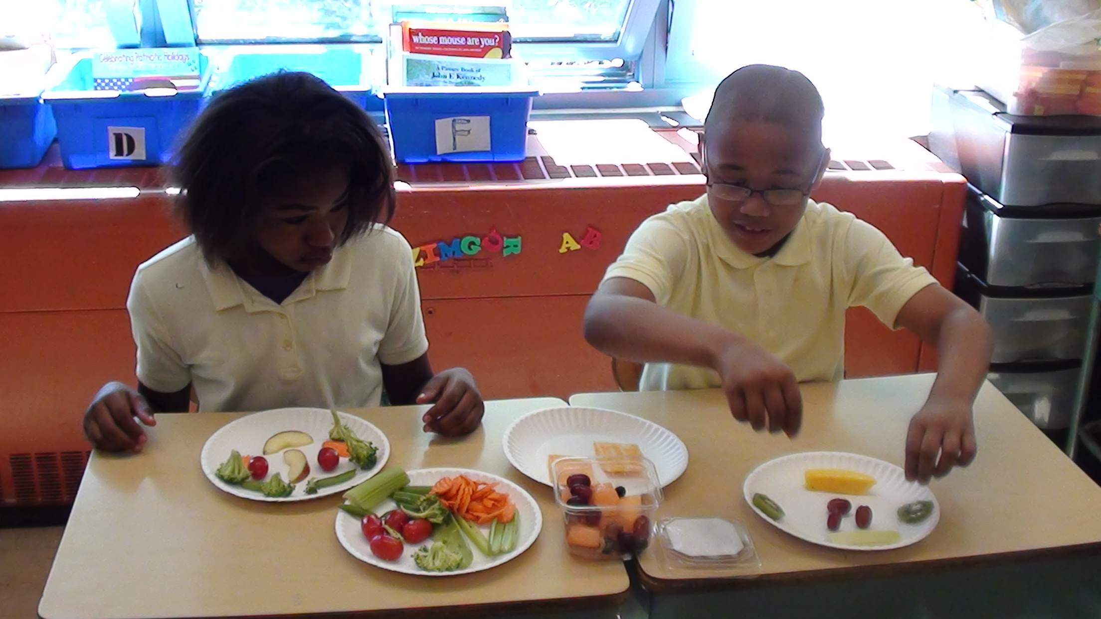
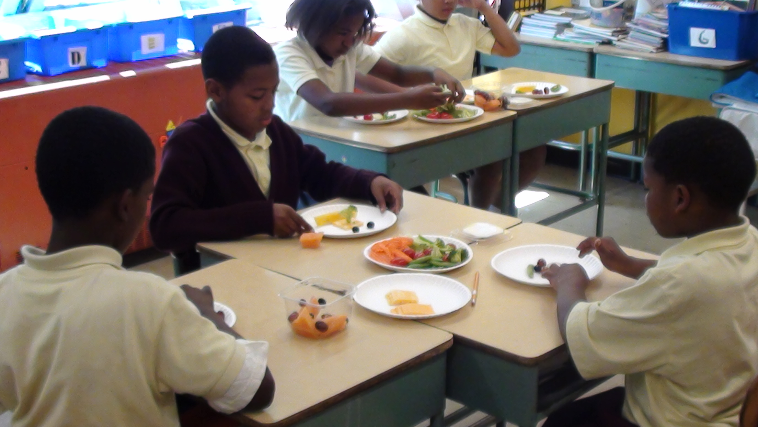

Slide 22
